Slide 1

Network Automation with Python
Scott Stephenson
Instructor Trainer

Slide 2
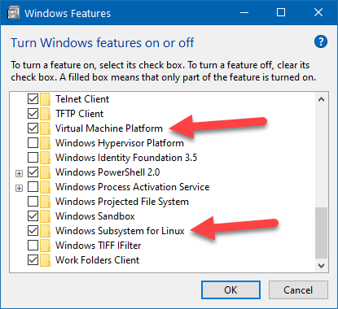
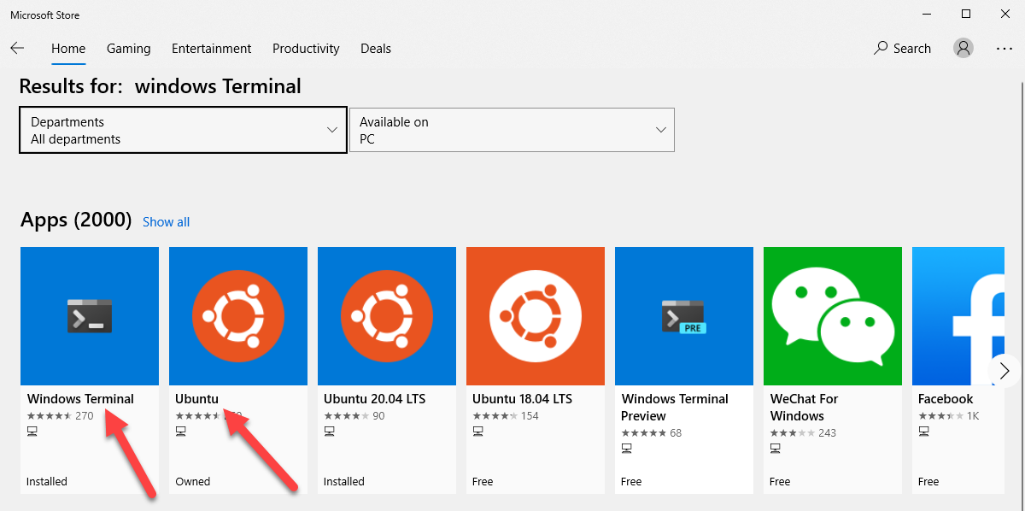
Before We Start
Turn On Windows Subsystem for Linux and Virtual Machine Platform
It will require a restart
Go to Windows Store and search for:
Windows Terminal
Ubuntu

Slide 3
Agenda
Why I created this lab?
What equipment do I need?
What is a Terminal Server?
What is CISSHGO?
Introduction to Windows Subsystem for Linux
Introduction to Windows Terminal
How to get started with Ubuntu
What is GitHub?
Introduction to VS Code

Slide 4
Why?
Why I created this lab?
To be used as lab for CCNA3 Chapter14: Network Automation and an introduction to Ansible in DevNet
What equipment can I use?
Any Cisco device with SSH (k9) capabilities (IOS 12.4 or higher)
1841, 1941, 4221, 4321, 4331, 2960, 3560
What about old devices (2501) or a Terminal Server (2511 or Raspberry Pi)?
You can use Python code to allow Telnet
Netmiko: cisco_ios_telnet
Python: telnetlib

Slide 5
What Software???
What is WSL?
Windows Subsystem for Linux
What is Windows Terminal?
Windows Terminal is a modern terminal application for users of command-line tools and shells like Command Prompt, PowerShell, and Windows Subsystem for Linux (WSL).
Its main features include multiple tabs, panes, and the ability to create your own themes and customize text, colors, backgrounds, and shortcuts.
How to start Ubuntu?
Gives you a Linux terminal directly in Windows without using virtual machines.
Great for learning Linux, Python, and network automation.

Slide 6
Windows Terminal
Windows Terminal is a new, modern, feature-rich, productive terminal application for command-line users. It includes many of the features most frequently requested by the Windows command-line community including support for tabs, rich text, globalization, configurability, theming & styling, and more.
Download from the Windows Store
Use winget (beta)– The winget command line tool enables developers to discover, install, upgrade, remove and configure applications on Windows 10 computers. This tool is the client interface to the Windows Package Manager service. winget install --id=Microsoft.WindowsTerminal –e
Launch from Start > Programs or Run > wt

Slide 7
Ubuntu
Ubuntu Desktop 20.04.2 LTS
Ubuntu is free
Based on Debian Linux
Available in the Windows Store (for use in Windows Terminal)
Can be installed on physical equipment or in virtual machines
Available at: https://ubuntu.com/#download
How to start Ubuntu?
Always open it from within Windows Terminal
Can be set as the default terminal to open.

Slide 8
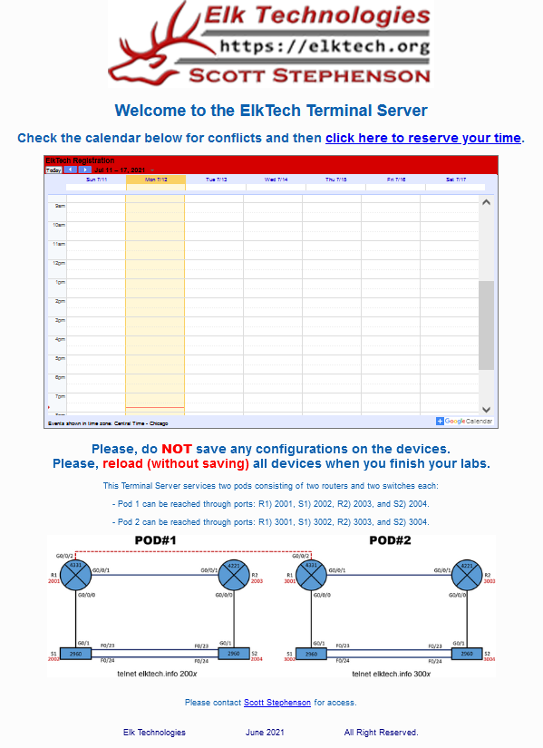
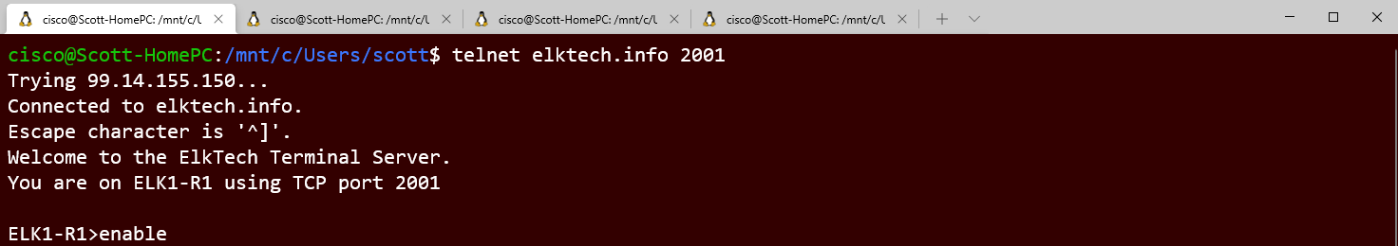
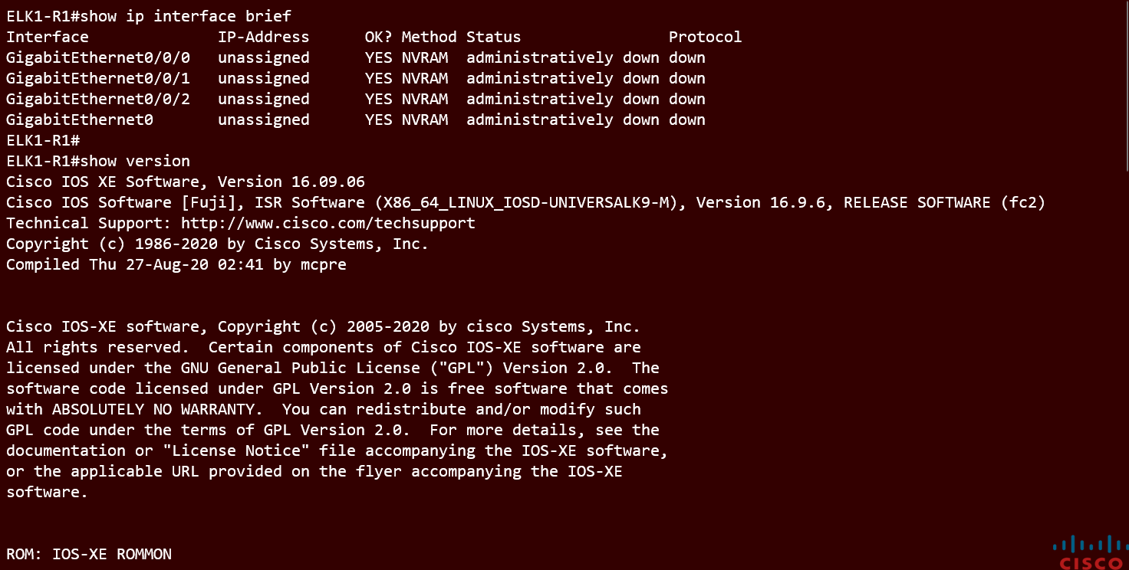
ESC11's Terminal (Telnet) Server
http://netacad11.info/

Slide 9
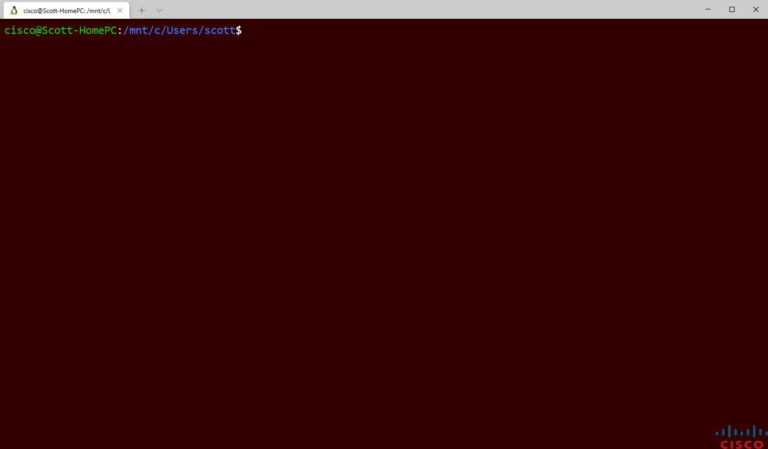
Serial Port Connection
Install screen app:
sudo apt install screen
Find the correct port:
ls /dev/*USB*
Open the port:
sudo screen /dev/ttyUSB0 9600
cisco@Scott-HomePC:/mnt/x/Users/scott$
sudo apt install screen
cisco@Scott-HomePC:/mnt/x/Users/scott$
ls /dev/*USB*
/dev/ttyUSB0
cisco@Scott-HomePC:/mnt/x/Users/scott$
sudo screen /dev/ttyUSB0 9600
Authorized access only! Violators will be prosecuted to the full extent of the law.
User Access Verification
Username:

Slide 10
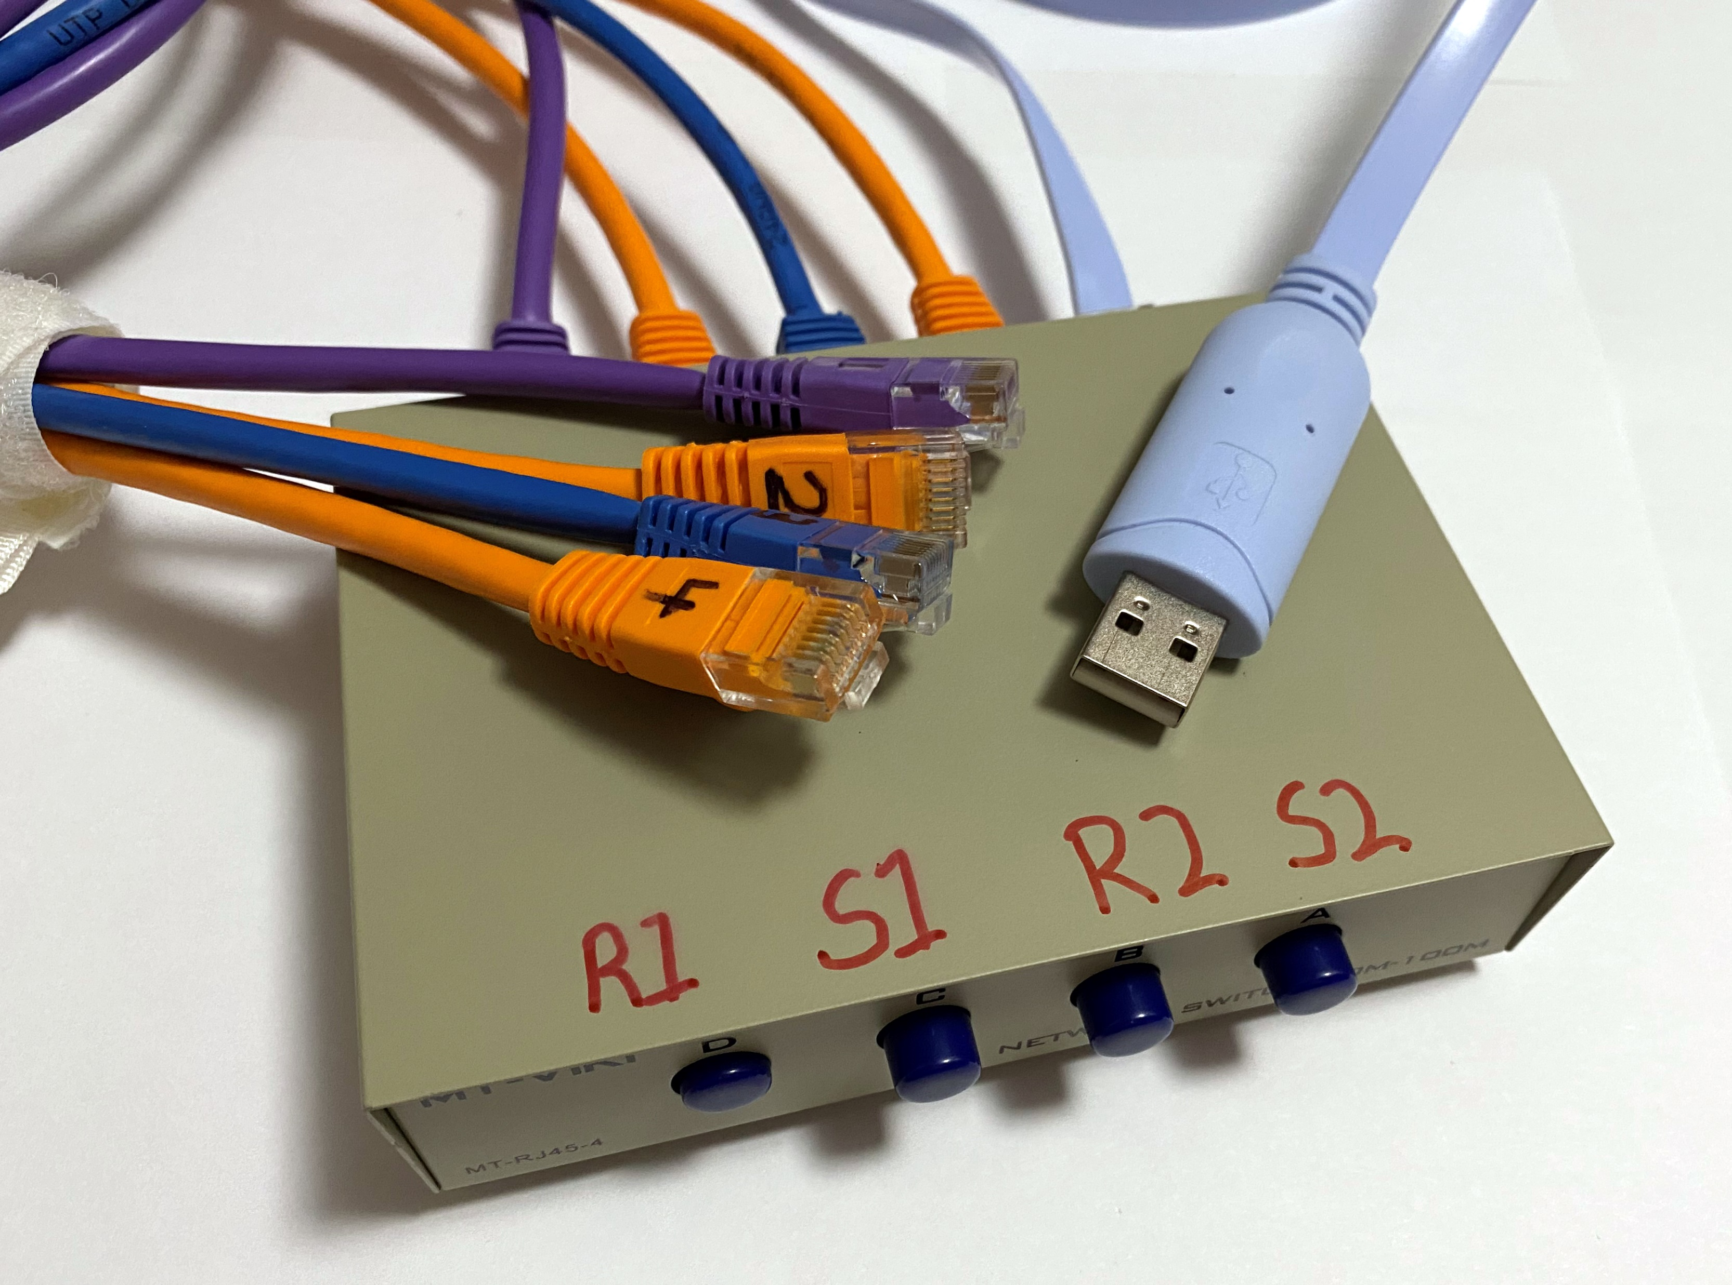
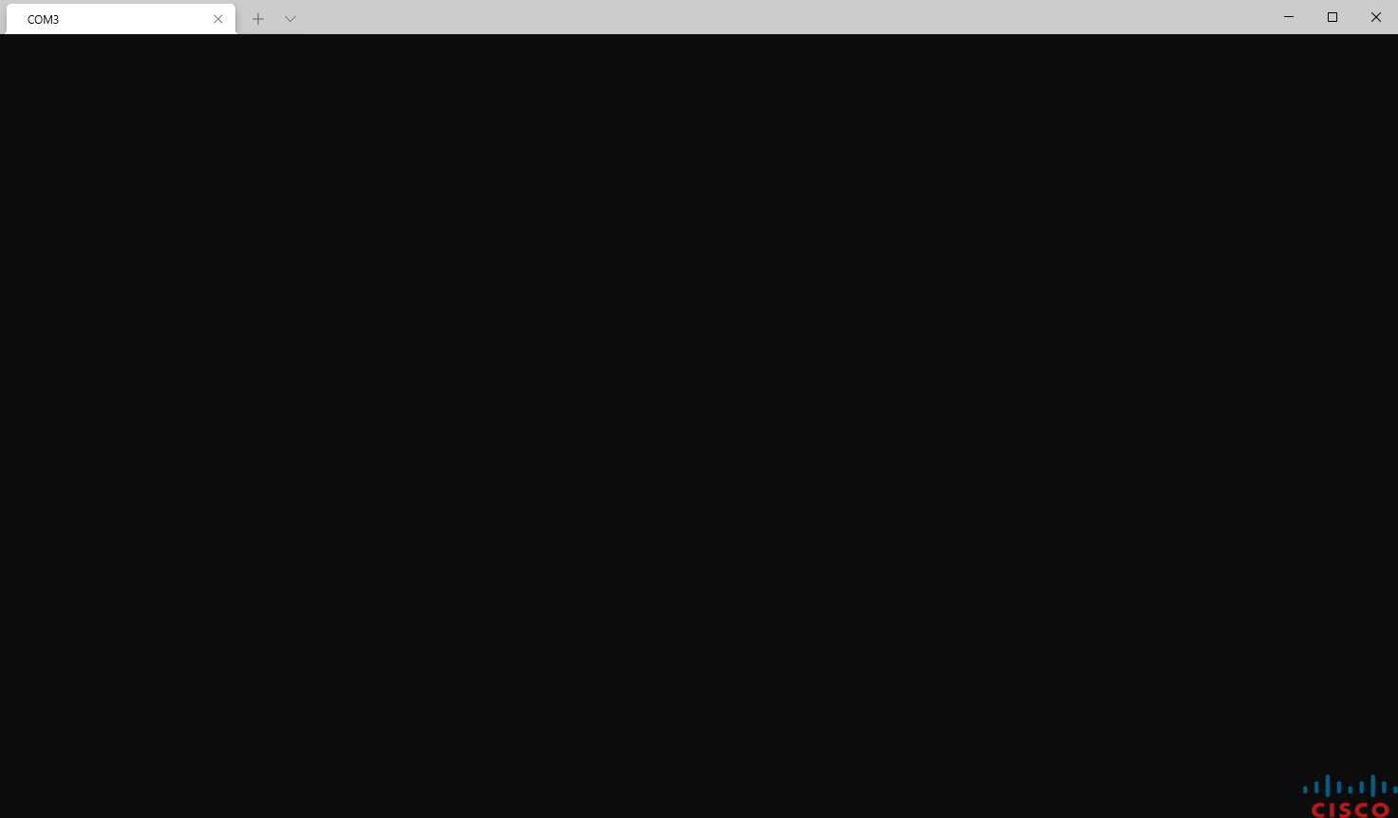
Windows Terminal as a Serial Port
Username: cisco
Password:
R1>

Slide 11
SSH Connection
Open the SSH connection:
ssh admin@192.168.1.1
Add a Key exchange method attribute:
-o KexAlgorithms=diffie-hellman-group1-sha1
Add a Cipher:
-c aes256-cbc
Turn off Strict Host Key Checking:
-o StrictHostKeyChecking=no
Remove old Known Host:
ssh-keygen –f "/home/cisco/.ssh /known_hosts" –R "192.168.1.1"
cisco@Scott-HomePC:/mnt/x/Users/scott$
ssh admin@192.168.1.1 -o KexAlgorithms=diffie-hellman-group1-sha1 -c aes256-cbc

Slide 12
CISSHGO
CISSHGO is a simple, small, fast, concurrent SSH server to emulate network equipment (i.e. Cisco IOS) for testing purposes. This can be used for Cisco automation training when real devices aren't available.
It does NOT write configuration information.
Limited to 3 show command by default: show version, show ip interface brief, or show running-config
Other commands can be added by modifying the transcript_map.yaml file and supplying transcripts as needed.
Download my version at: git clone https://github.com/Scott4564/cisshgo_for_devnet.git
Uses the GO language. Install it at: sudo apt install golang-go
To execute, navigate to the cissogo folder and type: go run cissh.go

Slide 13
Using CISSHGO
cisco@Scott-HomePC:/mnt/c/Users/scott/WSL/cisshgo_for_devnet$ ip addr
0: eth0: <BROADCAST,MULTICAST,UP> mtu 1500 group default qlen 1
link/ether 70:71:bc:17:fe:a0
inet 172.30.50.50/24 brd 172.30.50.255 scope global dynamic
valid_lft 85157sec preferred_lft 85157sec
1: lo: <LOOPBACK,UP> mtu 1500 group default qlen 1
link/loopback 00:00:00:00:00:00
inet 127.0.0.1/8 brd 127.255.255.255 scope global dynamic
valid_lft forever preferred_lft forever
inet6 ::1/128 scope host dynamic
valid_lft forever preferred_lft forever
cisco@Scott-HomePC:/mnt/c/Users/scott/WSL/cisshgo_for_devnet$ go run cissh.go
2021/07/12 21:14:55 Starting cissh.go ssh server on port :10000
2021/07/12 21:14:55 Starting cissh.go ssh server on port :10001
2021/07/12 21:14:55 Starting cissh.go ssh server on port :10002
2021/07/12 21:14:55 Starting cissh.go ssh server on port :10003
2021/07/12 21:14:55 Starting cissh.go ssh server on port :10004
2021/07/12 21:14:55 Starting cissh.go ssh server on port :10005
|
cisco@Scott-HomePC:/mnt/c/Users/scott/WSL/cisshgo_for_devnet$ ssh admin@172.30.50.50 -p 10000
The authenticity of host '[172.30.50.50]:10000 ([172.30.50.50]:10000)' can't be established.
RSA key fingerprint is SHA256:FdA1OXXe5mh9L8TstHJpabx3I7r1DRQTK28jpnEj2kA.
Are you sure you want to continue connecting (yes/no/[fingerprint])? yes
Failed to add the host to the list of known hosts (/home/cisco/.ssh/known_hosts).
admin@172.30.50.50's password:
R1>
Look for the IP Address of your computer.
These will be out of order and will create 50 routers by default.
Open in a new tab.
Password is cisco.

Slide 14
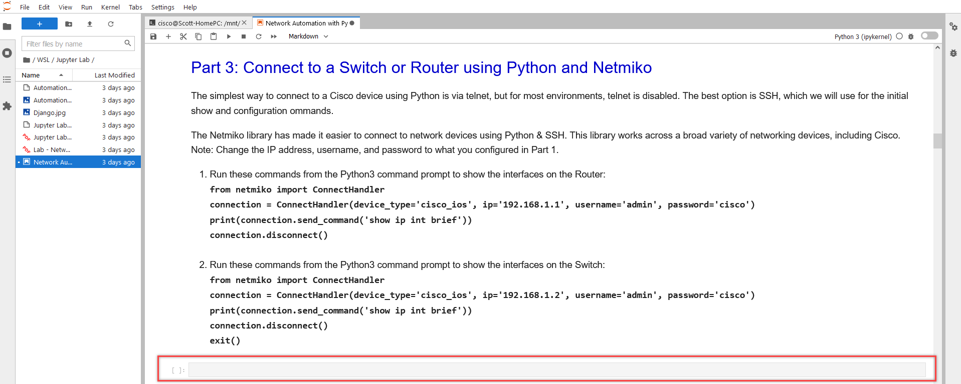
Jupyter Lab
Update to Jupyter Notebook

Slide 15
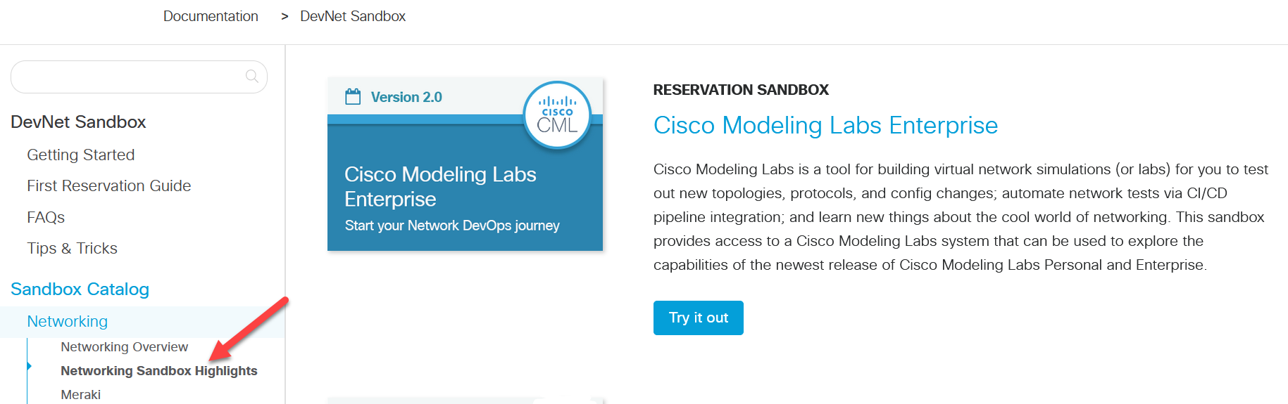
CML?
Cisco Modeling Labs - $200 per year
https://developer.cisco.com - Free

Slide 16
What is GitHub?
Git is the most widely used modern version control system in the world today. Git is an actively maintained open-source project originally developed in 2005 by Linus Torvalds, the famous creator of the Linux operating system kernel.
GitHub is a code hosting platform for version control and collaboration. It lets you and others work together on projects from anywhere.
With a few simple commands you and your student can use GitHub is share and collect assignments.
Get a free account at: https://github.com/

Slide 17
Introduction to VS Code
How to write Python code?
From any operating system with Python installed
From a Python shell
From Python IDLE
From a Python script
From any text editor (nano, vi, notepad)
From VS Code
Download and install from Windows https://code.visualstudio.com/download
To execute the VS Code application, navigate to the directory you want to open and type: code .

Slide 18


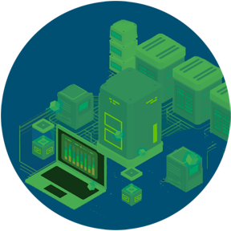

Connecting Existing Roles using Code
What is DevNet?
DevNet combines the skills needed for software development, network engineering, and network and infrastructure automation.
Software Development
Networking Engineering
Infrastructure Automation

Slide 19
DevNet
Module Title | Software
1. Course Introduction | Linux
2. The DevNet Developer Environment | GibHub
3. Software Development and Design | Python
4. Understanding and Using APIs | REST APIs Interact with REST APIs using Postman and Python code
5. Network Fundamentals | CCNA1: Intro to Networks
6. Application Deployment and Security | Docker
7. Infrastructure and Automation | Ansible
8. Cisco Platforms and Development | Compare Cisco platforms used for collaboration, infrastructure management, and automation

Slide 20
Automation Demo
Network Automation with Python

Slide 21
What is GitHub?
Git is the most widely used modern version control system in the world today. Git is an actively maintained open-source project originally developed in 2005 by Linus Torvalds, the famous creator of the Linux operating system kernel.
GitHub is a code hosting platform for version control and collaboration. It lets you and others work together on projects from anywhere.
With a few simple commands you and your student can use GitHub is share and collect assignments.
Part 2: Code for our session today:
cisco@pcname:/mnt/c/Users/user$
git clone https://github.com/Scott4564/python.git
cd python
cisco@pcname:/mnt/c/Users/user/python$

Slide 22
Let's Practice
Demo
Part 3 – 5 minutes
Part 4 – 10 minutes
Part 5 – 10 minutes
Part 6 – 15 minutes
Part 7 – 20 minutes
Total – 60 minutes

Slide 23
What is a Network Controller?
A network controller is a software that orchestrates network functions. It serves as an intermediary between the business and the network infrastructure. The organization enters their desired business objectives into the controller which in turn sets up the network to deliver on those objectives. Network controllers do their jobs by:
Maintaining an inventory of devices in the network and their status
Automating device operations such as configurations and image updates
Analyzing network operations, identifying potential issues, and suggesting remediations
Providing a platform for integration with other applications such as reporting systems
A network controller manages and orchestrates all aspects of a network making sure that it is operating flawlessly and delivering on business objectives. To better understand the role of such controllers, consider how network management has evolved.

Slide 24
What is a network controller's role in intent-based networking?
An intent-based networking (IBN) architecture builds on SDN and provides the building blocks that transform a hardware-centric, manual network into a software-driven network that continuously captures business intent, translates it into policies, and applies them consistently across the network.
A network controller acts as a central control point for network activity in an intent-based network.
Automation: A network controller uses automation extensively for configuring, managing, testing, deploying, and operating physical and virtual devices in a network.
Translation: A network controller translates business intent into policies that network devices can implement to help produce desired outcomes.
Activation: A network controller distributes desired policies across the physical and virtual network infrastructure, using networkwide automation.
Analytics: A network controller collects and analyzes telemetry data from network devices to help them operate smoothly and to spot any irregularities or potential issues.
Security: A network controller can help ensure that security measures are built into the network, compared with reliance on security applications to secure only the perimeter.
Integration: A network controller provides a central point for network orchestration, abstract individual devices, and expose a higher level of functionality through open-standard APIs.

Slide 25
Cisco Intent-Based Network Controllers
Cisco DNA Center
Cisco vManage
Cisco APIC

Slide 26
Let's Practice
Demo
Part 8 – 40 minutes
Part 9 – 20 minutes
Total – 60 minutes

Slide 27



